Slide 1
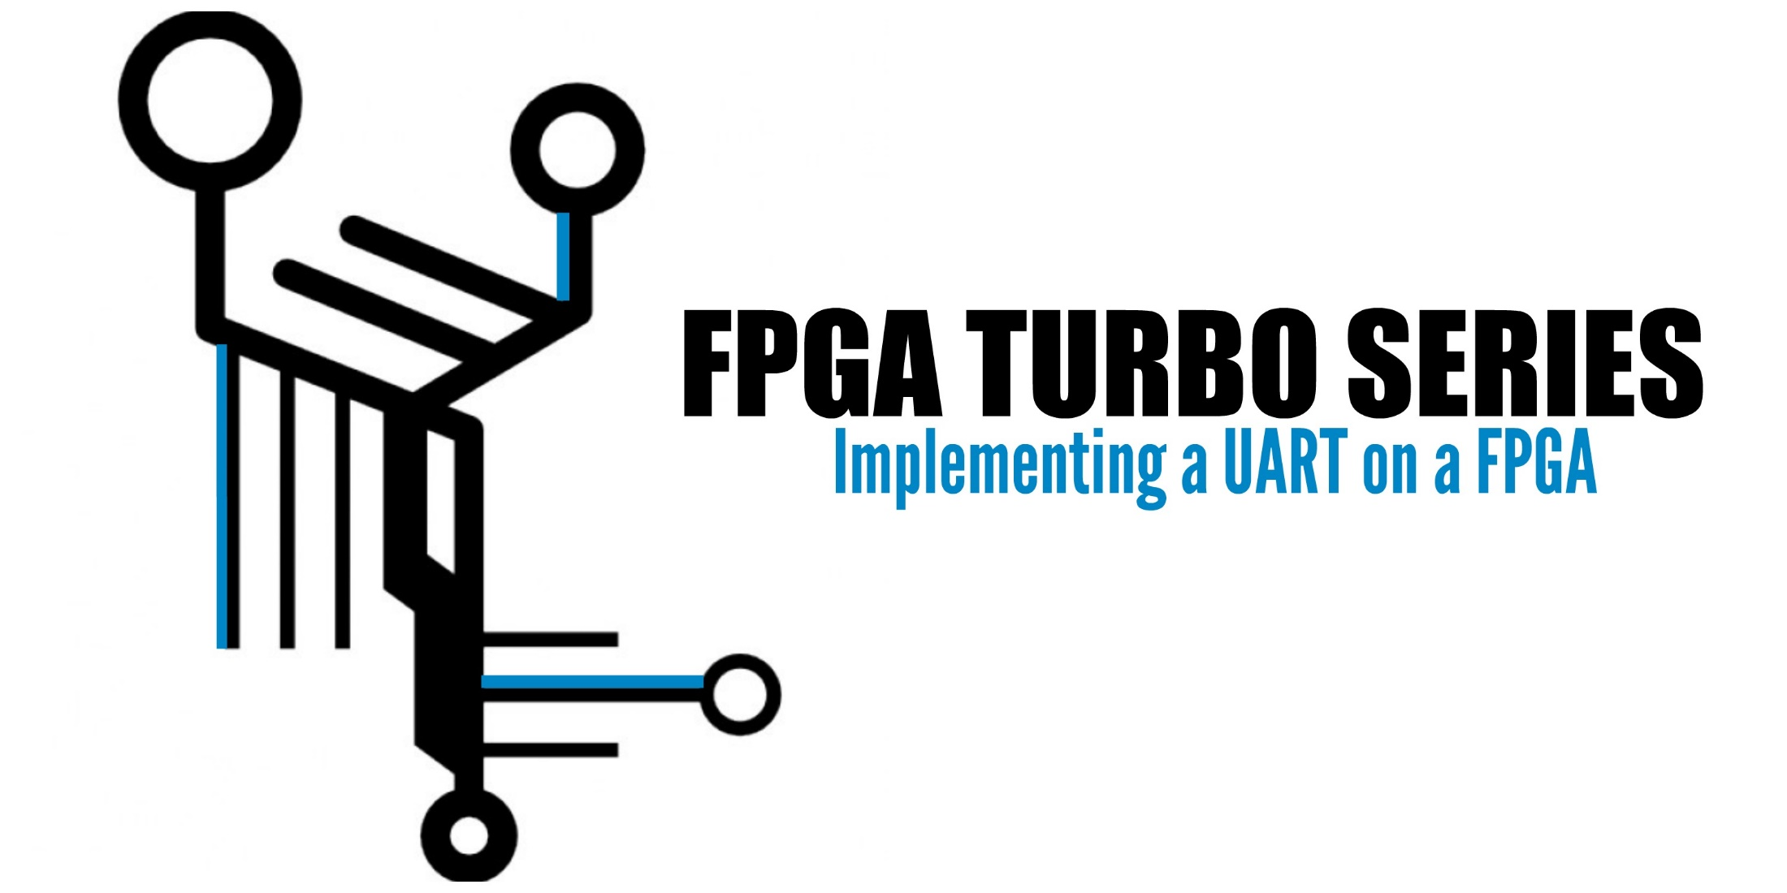

Slide 2
ASCII
Jordan Christman

Slide 3
ASCII
American
Standard
Code
for
Information
Interchange
Gives us a way to communicate letters and characters between computers and humans
We will be using this to transmit data to the FPGA
We will use this to interpret data received from the FPGA

Slide 4
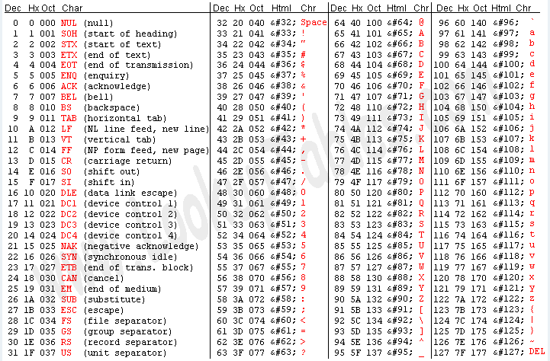
ASCII

Slide 5
ASCII
Jordan Christman

